Slide 1
Outland Adventures
Group 5 Case Study
Nicholas Bushnell
Eva Dukerschein
Samuel Litton

Slide 2
Nicholas Bushnell
Eva Dukerschein
Samuel Litton
About Us
Nicholas Bushnell is a Implementation Analyst located out in Ferdinand, Indiana and is currently pursuing Software Development at Bellevue University along with his cat, Aurora. On the side, he also works as a Freelance Photographer & Videographer that does work in business, weddings, and portraits.
Eva Dukerschein is a Software Development Student at Bellevue University and also works as an Industrial Sales Coordinator at WM. She lives with her wife and her dog in Madison, WI. For hobbies she enjoys sewing, knitting, and reading.
Samuel Litton is a Software Development student at Bellevue University, while also working as a barista at Target. He lives with his wife, Paige, in Columbia, South Carolina. He enjoys going longboarding and playing video games in his free time.

Slide 3

Together, our group worked on creating a database for Outland Adventures. Outland Adventures is a growing company that is looking to expand their business and needs a database to make business decisions from.

Slide 4

Outland Adventures is a growing company that specializes in hiking and camping treks in exotic locales. As they continue to grow they are hoping to optimize their business strategy. There are three areas they are most concerned with are the sales of their equipment, booking trends, and inventory age. They need to know if they are making enough sales to justify continuing to sell equipment, they want to know if there are locations that are performing poorly, and they want to keep an eye on the age of the equipment they rent and sell.
Case Study Description

Slide 5
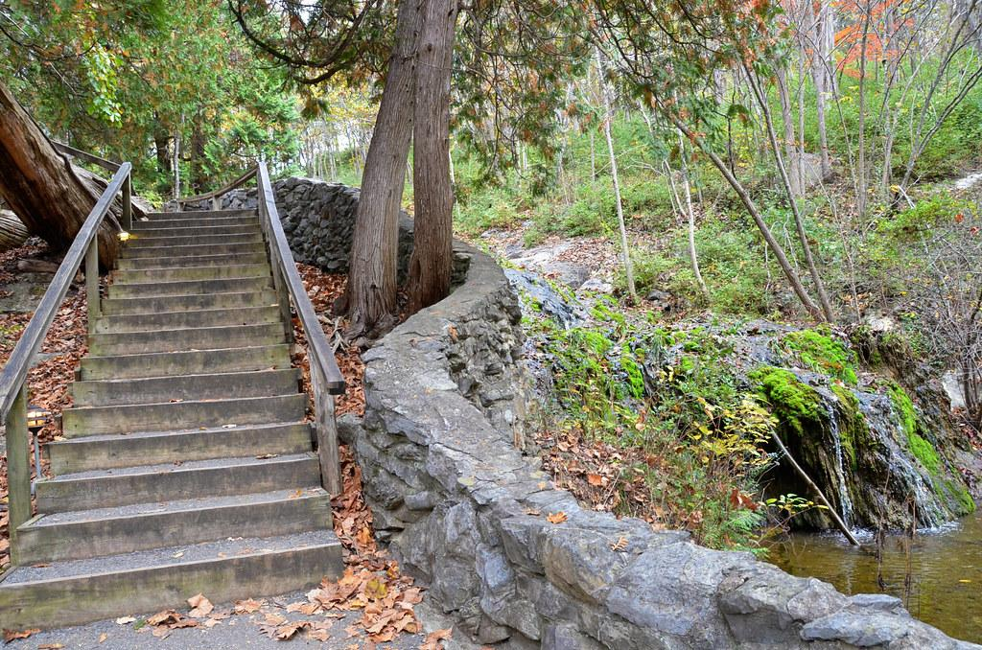
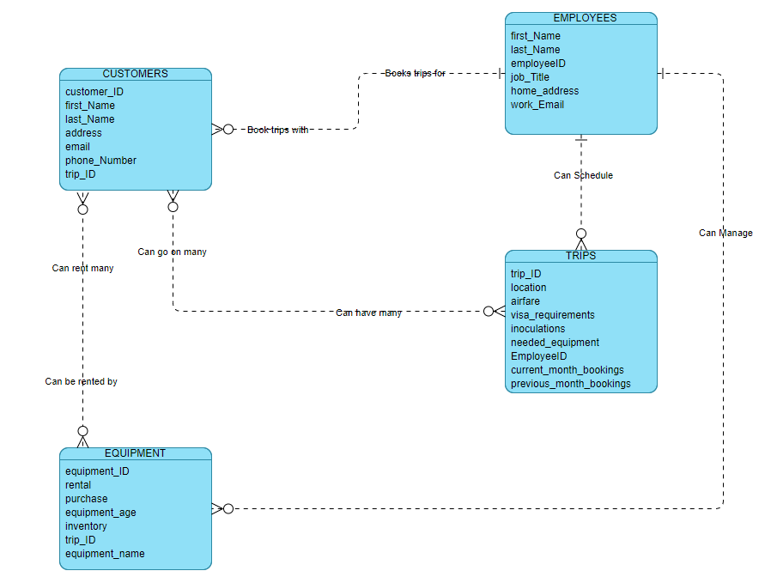
Finalized ERD

Slide 6
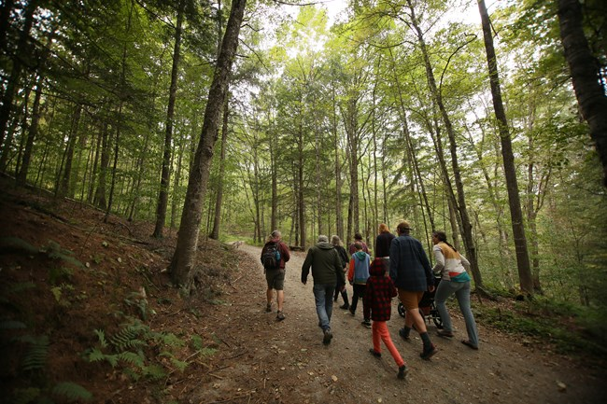
The Reports

Slide 7
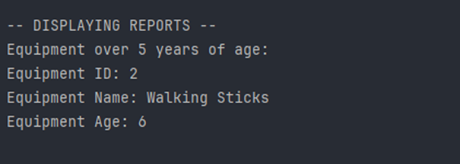
Report 1
The client wanted to know if there are inventory items that are over the age of 5, so that they can replace them. Our group provided them with a report of all inventory items that are over 5 years old, alongside its ID and name.

Slide 8
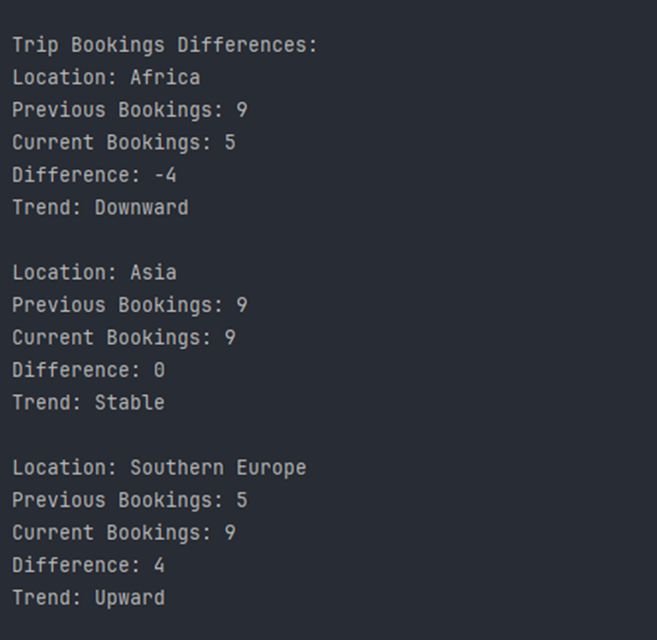
Report 2
The client has three locations that they provide trips to, Africa, Asia and Southern Europe. They wished to know the trends of these locations and more specifically, if any of these areas has a downward trend of bookings. Our group provided a report of all three locations and their booking statistics.

Slide 9
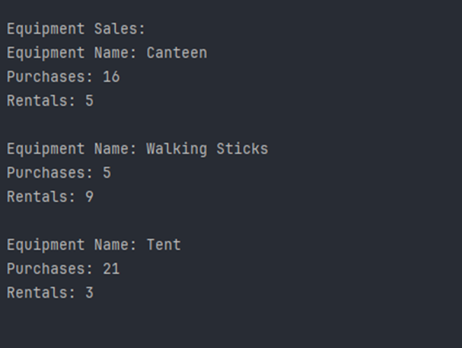
Report 3
The client was concerned about whether or not customers purchase enough equipment for it to make sense to even provide the option of purchasing equipment or if they should only rent out equipment. Our group provided a report of each item in their equipment inventory and how many customers have purchased that item and how many customers have rented that item.

Slide 10
Assumptions
Throughout the case study the owners of Outland Adventures, Blythe Timmerson and Jim Ford, make strides to make sure to increase the efficiency of Outland Adventures by making sure to recruit individuals that guided tours on trips, organized and planned trips, and helped with increasing revenue including marketing, inventory, and website development. By evaluating this, we can assume that there will be a focus on tracking important statistics including the questions that Blythe and Jim had concerning equipment sales, booking trends and inventory age. With this information, we made sure that our design showcased these statistics in areas that would be easy to find, understand, and review.

